Slide 1

SECURING DATA WITH
BLOCKCHAIN TECHNOLOGY
-Presented By – Shivani Satish Mali
Roll No – 149

Slide 2

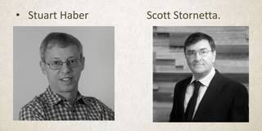
HISTORY:
In 1991, Stuart Haber and W. Scott Stornetta published an article that outlined the first version of blockchain technology
Satoshi Nakamoto is credited with inventing the first decentralized blockchain in 2008.

Slide 3
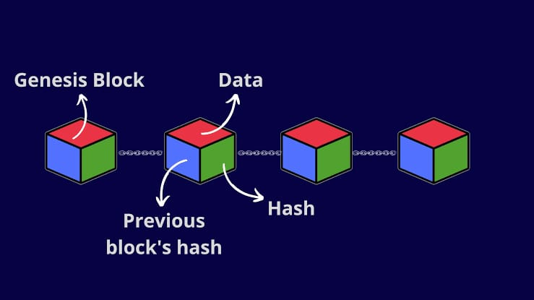
Introduction to Blockchain
What is Blockchain?

Slide 4
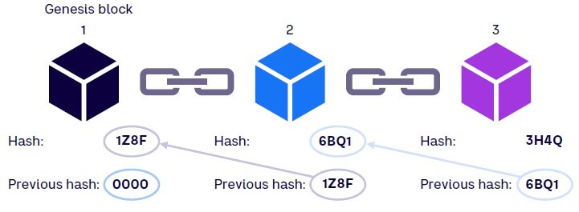
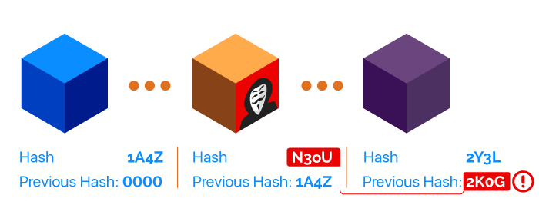
Arrangement Of Block’s
Tempering the Block - Chain

Slide 5
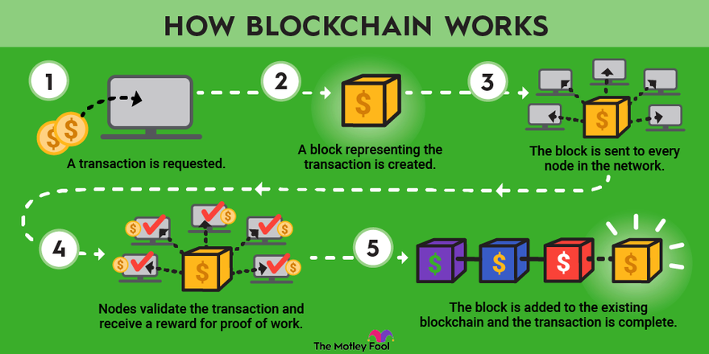

Slide 6

Key Features of Blockchain
Decentralization
Transparency
Immutability

Slide 7
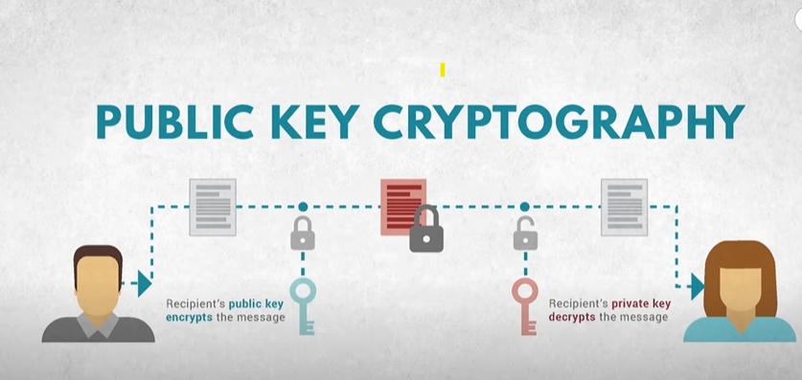
Why Blockchain Technology is Secure
Public Address = Random combination of numbers and digits.
Shared like an email ID, not the private key.
Votes cast via public address ensure anonymity.
Name and identity remain private.

Slide 8

Blockchain in Data-security
How Blockchain Improves Security:
Adds a secure layer to protect data.
Creates an unchangeable audit trail to detect breaches.
Benefits for Organizations:
Reduces data breach risk.
Builds a secure transaction record.​

Slide 9

Use Cases in Various Industries
Finance
Healthcare
Supply Chain

Slide 10

Blockchain in Space Missions
How Blockchain Secures Space Data:
Decentralized Ledger
Secure Transmission
Real-time Auditing
Benefits:
Data Integrity
Security
Collaboration
Challenges:
Technical integration.
Scalability issues.
Lack of global standards.

Slide 11
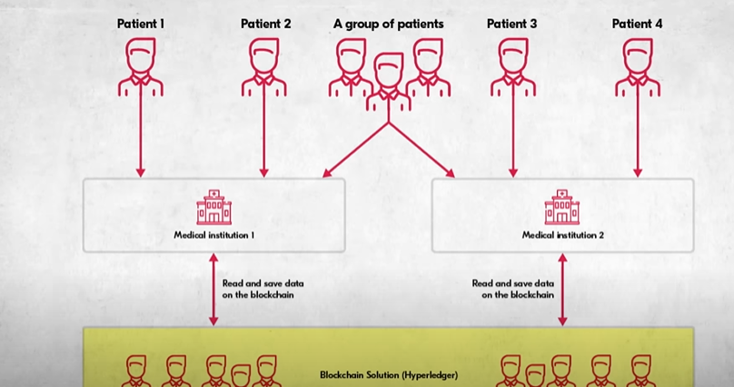
Challenges of Implementation
Scalability Issues
Regulatory Concerns
Integration Difficulties
For example:

Slide 12
Conclusion
Blockchain’s Impact: Provides a secure, trusted way to protect data
Future Potential: Likely to expand in space missions and other fields
Takeaway

Slide 13
Any Questions?

Slide 14
Thanks!

